Slide 1
www.escpweb.org

Slide 2
23rd Oct 2018 | 24th Oct 2018 | 25th Oct 2018 | 26th Oct 2018
Masterclass Queen’s University | Symposium Belfast Waterfront | Symposium Belfast Waterfront | Symposium Belfast Waterfront
 | Welcome Reception Belfast City Hall | Conference Dinner Europa Hotel | Farewell Drink Belfast Waterfront
PROGRAMME OVERVIEW
www.escpweb.org
Notes:
Wheel at Belfast City Hall, Northern Ireland
Image ID: 23935117

Slide 3
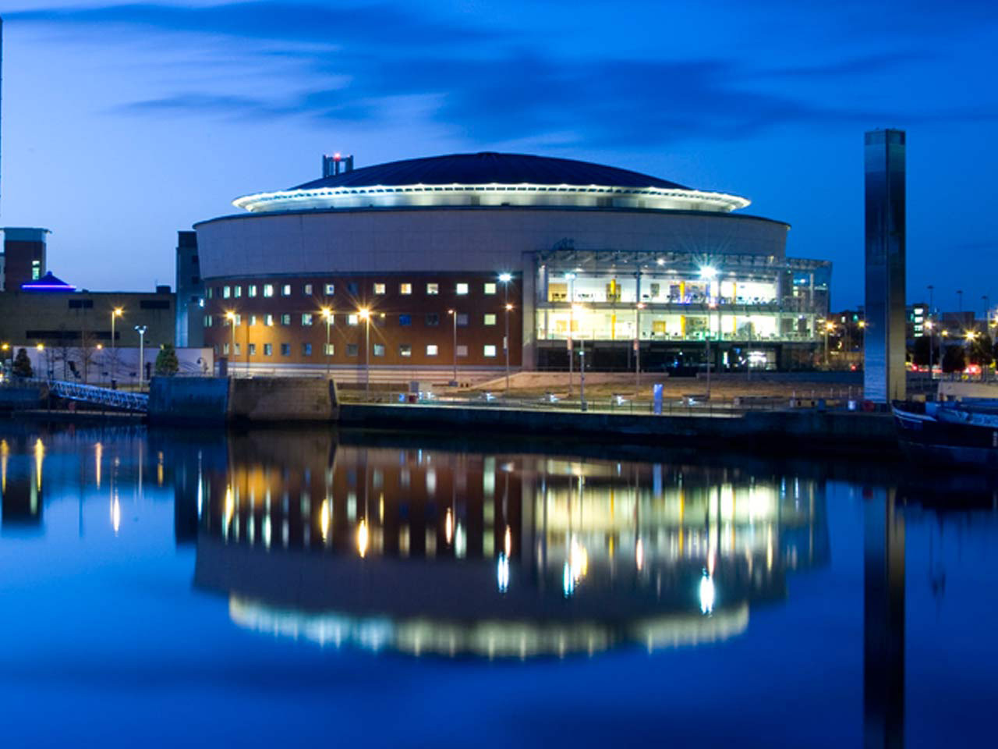
CONFERENCE VENUE
BELFAST WATERFRONT
www.escpweb.org

Slide 4
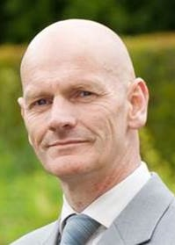
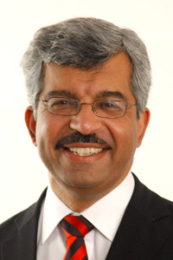
Masterclass Evening Opening Lecture
‘We are what we eat’
Chris Elliott
Professor of Food Safety, Queen’s University Belfast
23rd October
Riddel Hall
Queen’s University
Belfast
Symposium Lecture
‘Personalised/precision/stratified medicine – basic concepts’
24th to 26th October
Belfast Waterfront Conference
& Exhibition Centre
Sir Munir Pirmohamed
Chair in Medicine, University of Liverpool
Notes:
Wheel at Belfast City Hall, Northern Ireland
Image ID: 23935117

Slide 5
23rd June | Notification of Abstract Acceptance
31st July | Early-Bird Registration Deadline
1st October | Regular Registration Deadline
2nd - 26th October | Late Registration Fees
23rd October | Masterclass, Queen University
24th - 26th October | Symposium, Belfast Waterfront
ESCP 2018 Symposium
Important dates and deadlines
www.escpweb.org
Notes:
Wheel at Belfast City Hall, Northern Ireland
Image ID: 23935117

